Slide 1
IMS CLI Java Project
Sehrish Balouch

Slide 2
My name is Sehrish and I am an aspiring software developer and current Cyber Security Student
I approached this project via the agile methodology of developing applications
I had to self organize and plan everything out including the models and their relationships
I used a Jira board to give myself goals and also plan out user stories and user experience when using this application
I created an ERD which helped me map out the relationships between the models of customers, items, and orders
I also did a risk assessment of what would happen to the completion of the project given different circumstances

Slide 3
Technologies used for this project
I had to learn a few Java technologies for this project
One of them was Maven which is a project management tool for Java that enables you to build projects how you want
It utilizes the POM (project object model) to configure all of a project’s dependencies
Another tool I learned was Mockito and Junit testing
Mockito is a testing framework which allows a developer to perform unit tests by ‘mocking’ interfaces and behavior of methods in an application
I learned about JAR files which is an archive file used to aggregate many Java classes

Slide 4

I used git which is a a software tracking changes in a file for version control
I created several feature branches for individual features of the app
I pushed changes frequently to github
I then merged all the feature branches to the dev branch and then the dev branch to the main branch

Slide 5
User
Stories
Users should be able to create, read, update and delete items, orders and customers
Users should be able to navigate the application via the user menu
Users should be able to exit the application

Slide 6
Sprint Review
I was able to give the domains of customer, item, and orders full CRUD functionality
I was able to do some unit testing
I was unable to perform full coverage an tests

Slide 7
Sprint Retrospective
The building of the classes went very well
Too much information was consolidated into a short time so I had little time to fully grasp certain concepts
I feel like more time was needed to adequately fulfill all the requirements

Slide 8
Conclusion
I feel like the end product was adequate
Future steps are to improve the interface and add more adequate testing
I might add a UserItem DAO and Controller as well

Slide 9
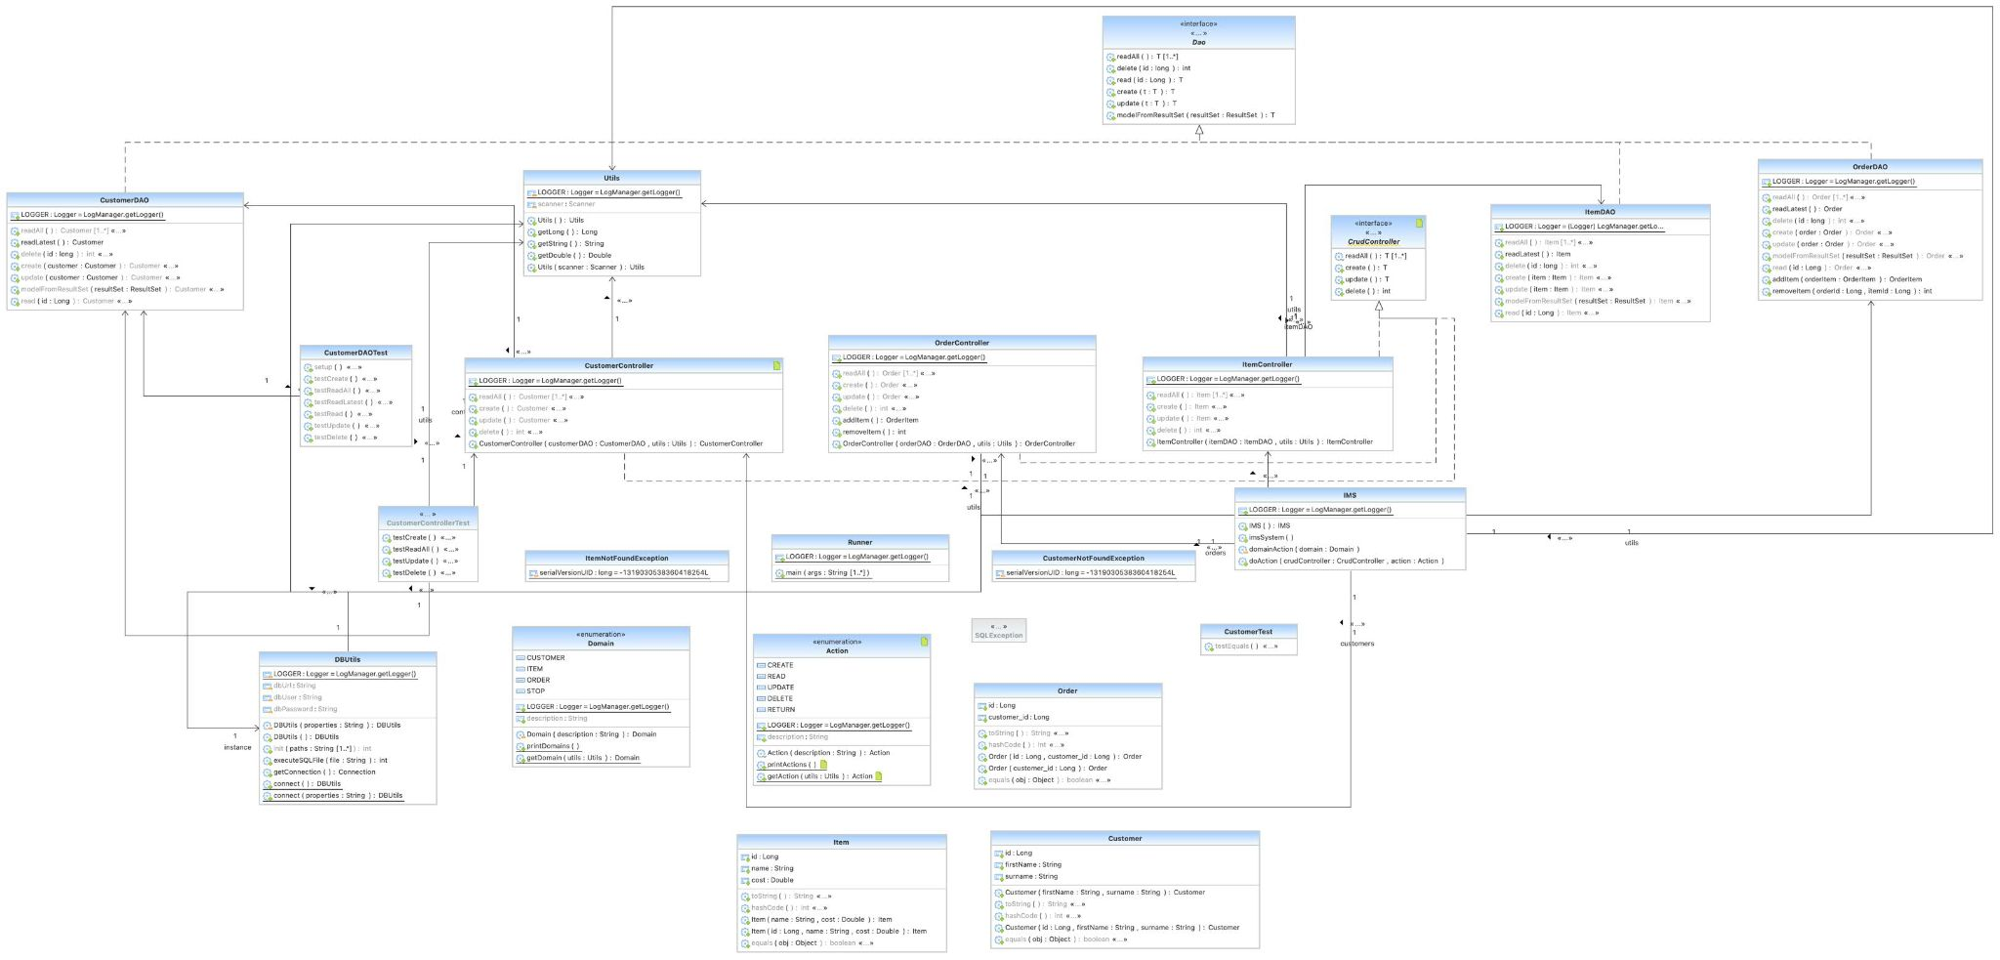

Slide 10
